Slide 1
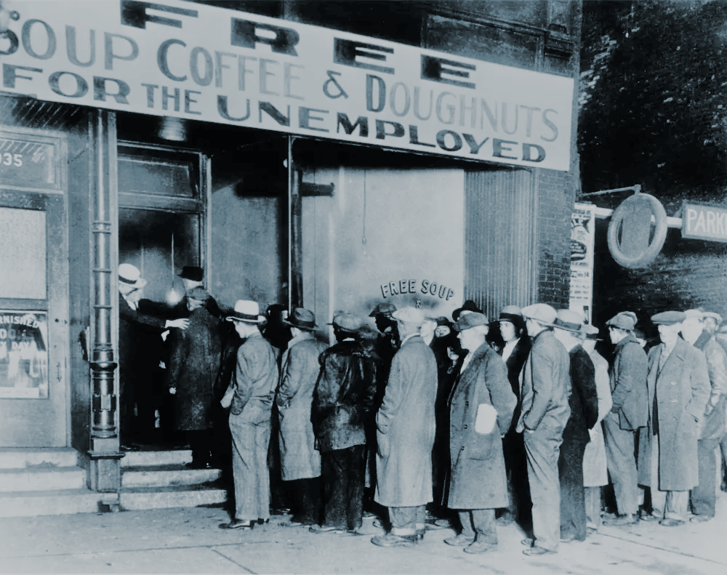
Analyzing Global Ongoing Covid-19 Depression
—Predicting Continued Claims in US Using Time Series
By Iris Xv, Erica Zhang, Ronald Xie, & Bruce Zhao

Slide 2
Introduction
Iris Xv

Slide 3
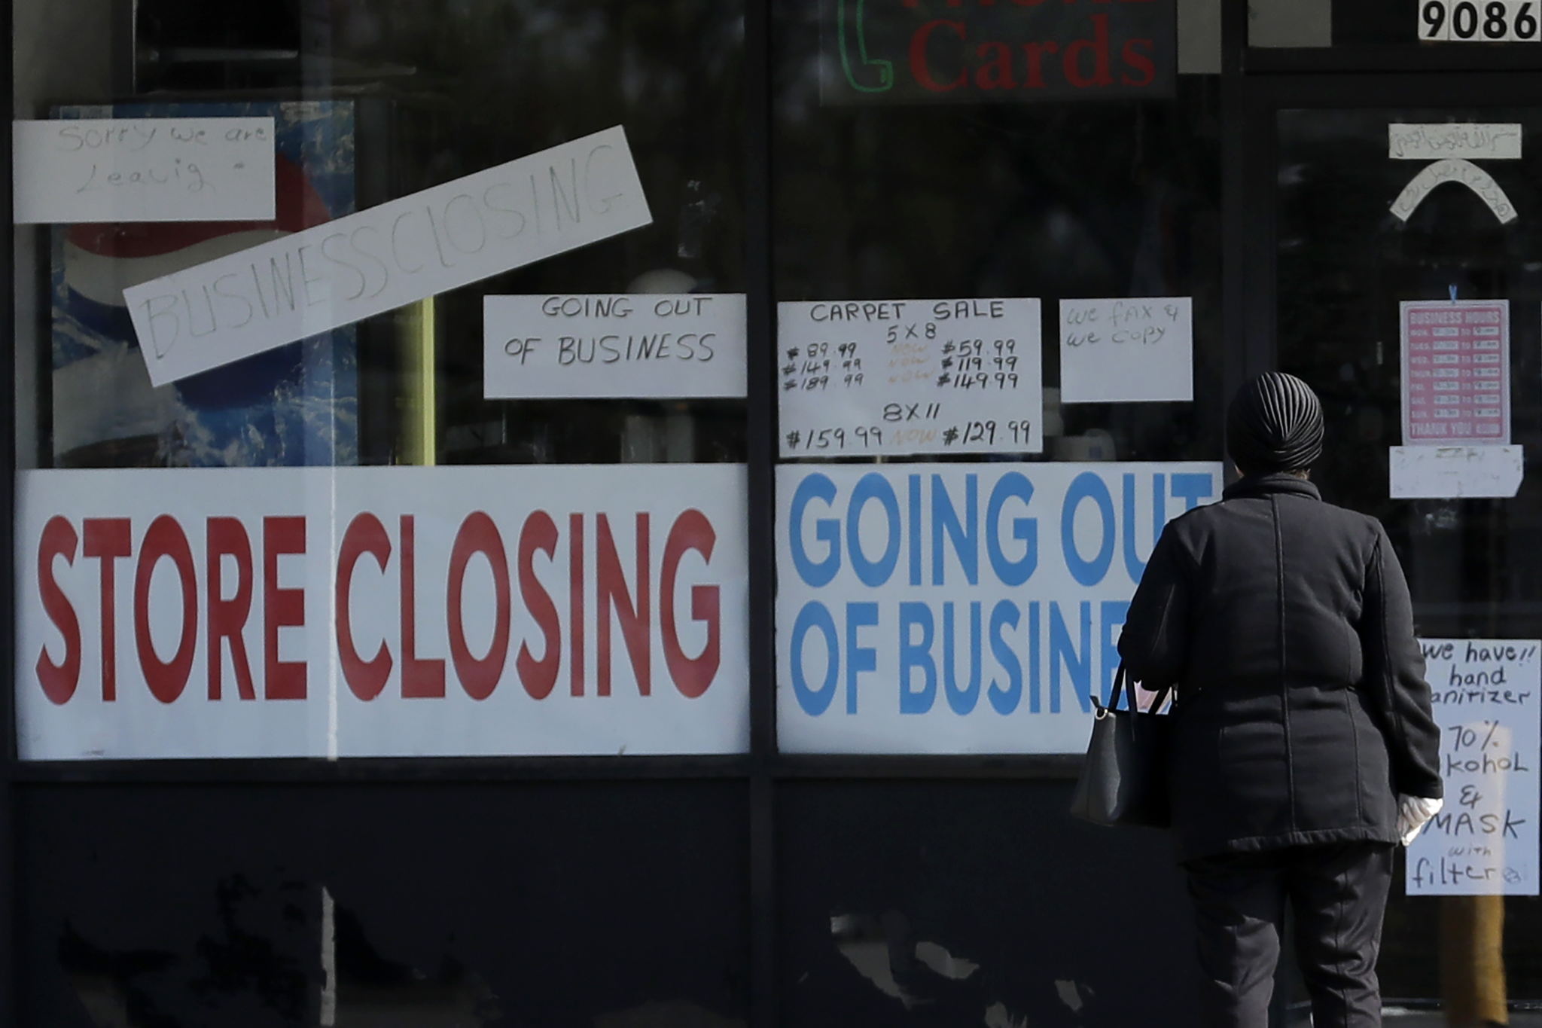
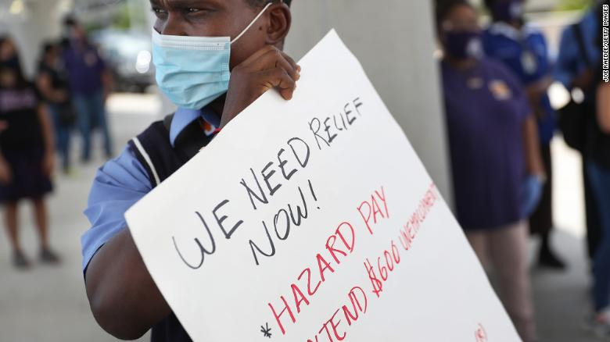
Background
The wave of initial job losses during the coronavirus disease 2019 (COVID-19) pandemic has been massive.
During the start of the epidemic (April 2019), more than 20 million jobs were removed.
Unemployment soared in April to the highest level since the Great Depression of the 1930s.

Slide 4
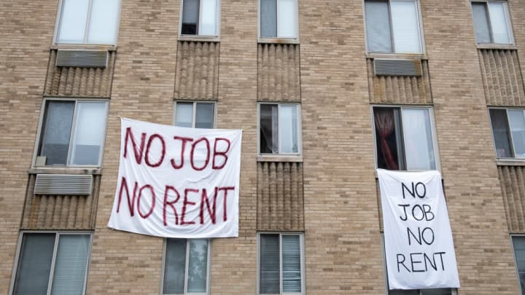
Motivation
The U.S. labor market is now under tremendous stress as a result of the COVID-19 outbreak and subsequent mitigation measures.
Forecasting future U.S. unemployment rates based on continued claim.Two separate time periods: 2000/01/01 to 2022/08/06; 2010/1/2 to 2022/08/06.
Give the government more professional advice to solve the unemployment problem.
U.S. unemployment Model as good case study when researching other economies(such as EU)

Slide 5

Sources
Continued Claims: produced by the Bureau of Labor Statistics (BLS), is a count of the number of individuals who have lost their jobs and applied for unemployment benefits.
Our data based on Unemployment Insurance Weekly Claims Report by U.S. Employment and Training Administration(ETA).
Benfits of Weekly data

Slide 6
Method
Erica Zhang

Slide 7
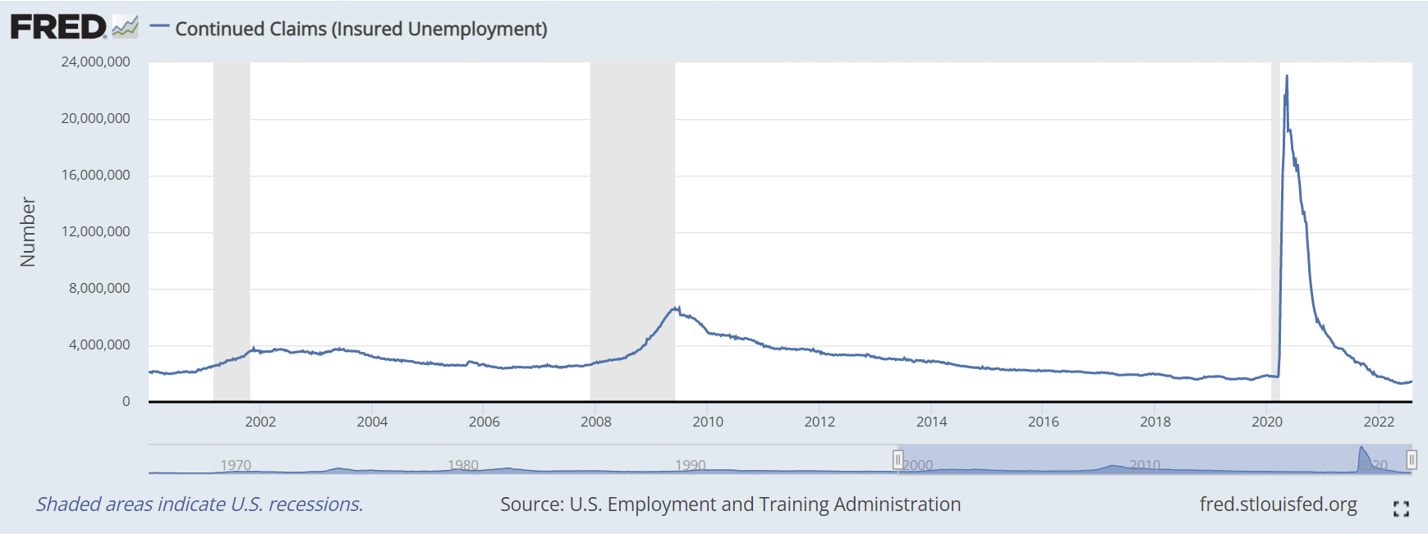
Data selection
2000/1/1 ——2022/8/6

Slide 8
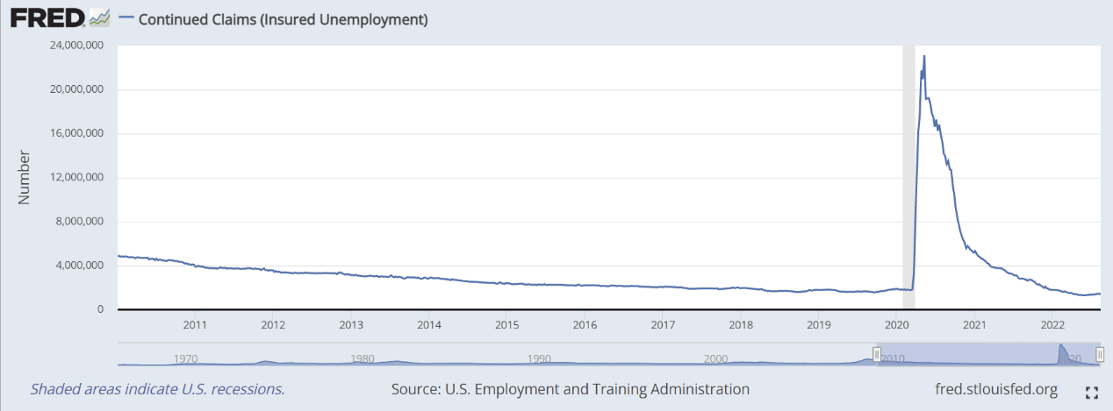
Data selection
2010/1/2——2022/8/6

Slide 9
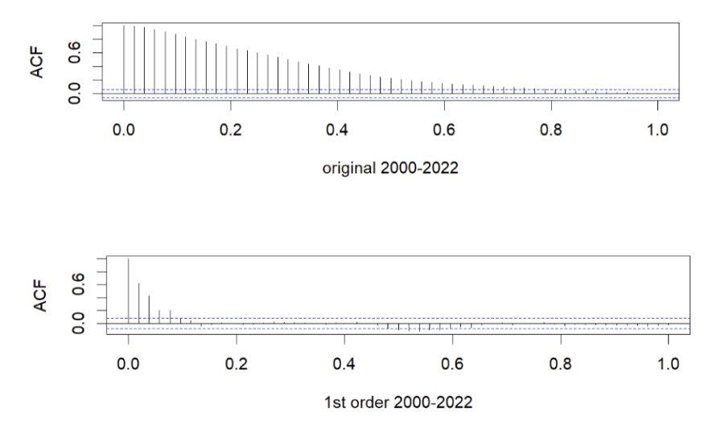
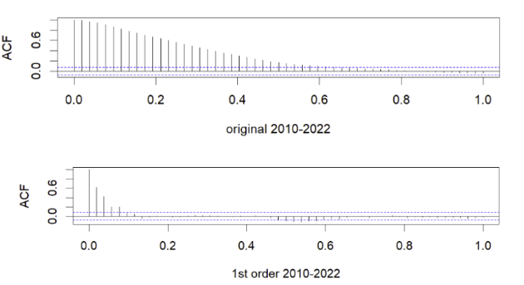
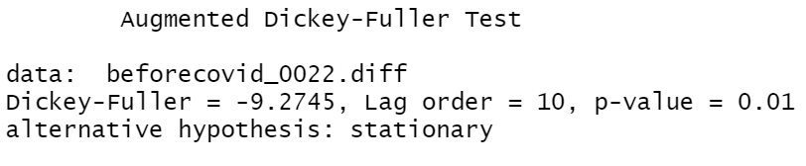
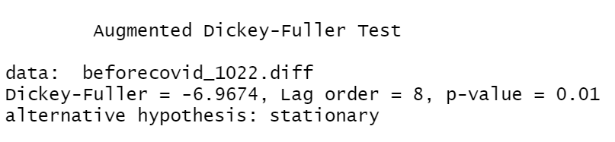
Stationary
2000-2022 2010-2022

Slide 10
ETS model -error, trend, seasonal
ETS(A,Ad,N): Damped trend method with additive errors
2000-2022 training set
 | ME | RMSE | MAE | MPE | MAPE | MASE | ACF1
A,N,N | -191.6324 | 316427.7 | 74363.43 | -0.080990 | 1.532822 | 0.0577305 | 0.4174190
A,Ad,N | -118.2579 | 256812.8 | 66621.9 | 0.0261388 | 1.521314 | 0.0517206 | -0.046348
M,N,N | -191.6324 | 316427.7 | 74363.43 | -0.080990 | 1.532822 | 0.0577305 | 0.4174190
M,A,N | -48.86183 | 303250.2 | 84348.18 | 0.0545740 | 1.949534 | 0.0654820 | -0.503074
M,M,N | -10427.61 | 327664.1 | 85306.44 | -0.062987 | 1.886535 | 0.0662259 | -0.427985

Slide 11
ETS model -error, trend, seasonal
ETS(A,Ad,N): Damped trend method with additive errors
2010-2022 training set
 | ME | RMSE | MAE | MPE | MAPE | MASE | ACF1
A,N,N | 2466.332 | 58279.62 | 40955.51 | 0.0746414 | 1.21427 | 0.0556077 | -0.019109
A,Ad,N | 646.8287 | 51408.94 | 36967.71 | 0.028416 | 1.122893 | 0.0501932 | 0.0171395
M,N,N | 2640.577 | 58461.9 | 40985.07 | 0.0801749 | 1.209629 | 0.0556478 | 0.0617612
M,A,N | 619.226 | 51701.5 | 36660 | 0.0319464 | 1.110526 | 0.0497754 | 0.0208734
M,M,N | -427.5728 | 51631.57 | 36538.94 | 0.0059866 | 1.107856 | 0.0496110 | 0.0207703

Slide 12
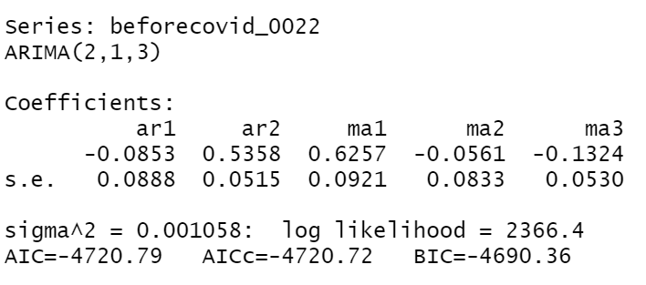
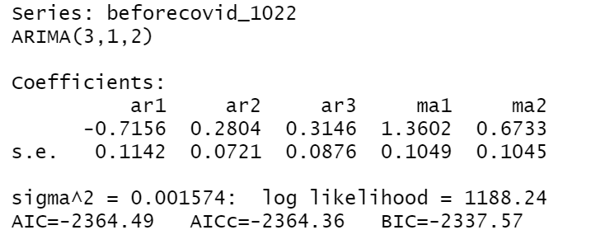
ARIMA Model- autoregressive integrated moving average
ARIMA(p,d,q):
p: the number of lag observations in the model.
d: the number of times that the raw observations are differenced.
q: the size of the moving average window.
2000-2022 ARIMA(2,1,3) 2010-2022 ARIMA(3,1,2)

Slide 13
Forecasting Performance Comparison
RMSE
AIC/BIC
Residual Analysis
Notes:
Next, Ronald will use the following three steps to present our forcasting results & making forecasting performance comparison between ETS & ARIMA model that I just mentioned.

Slide 14
Results
Ronald Xie

Slide 15
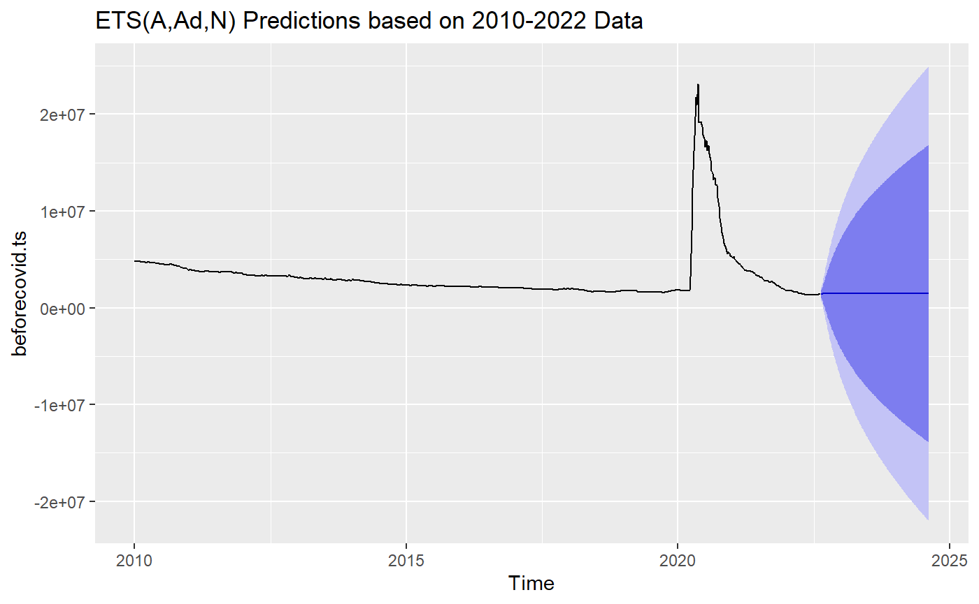
Prediction Results for 2010-2022

Slide 16
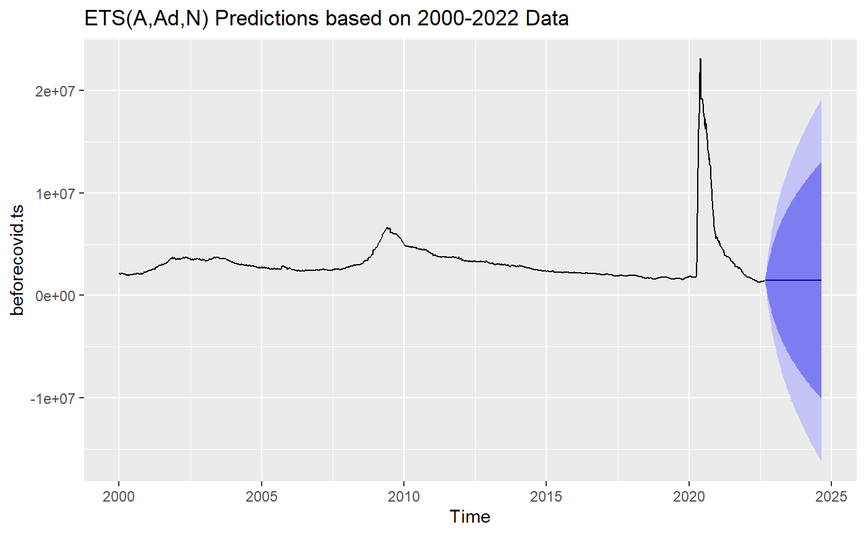
Prediction Results for 2000-2022

Slide 17
Comparing ETS Prediction Results
ETS(A,Ad,N) 2010-2022 | 1,448,535 | 1,454,663 | 1,459,564 | 1,463,486 | 1,466,623 | 1,469,133
 | 1,471,140 | 1,472,747 | 1,474,032 | 1,475,060 | 1,475,882 | 1,476,540
ETS (A,Ad,N) 2000-2022 | 1,448,623 | 1,454,795 | 1,459,732 | 1,463,682 | 1,466,842 | 1,469,370
 | 1,471,393 | 1,473,011 | 1,474,305 | 1,475,340 | 1,476,169 | 1,476,831

Slide 18
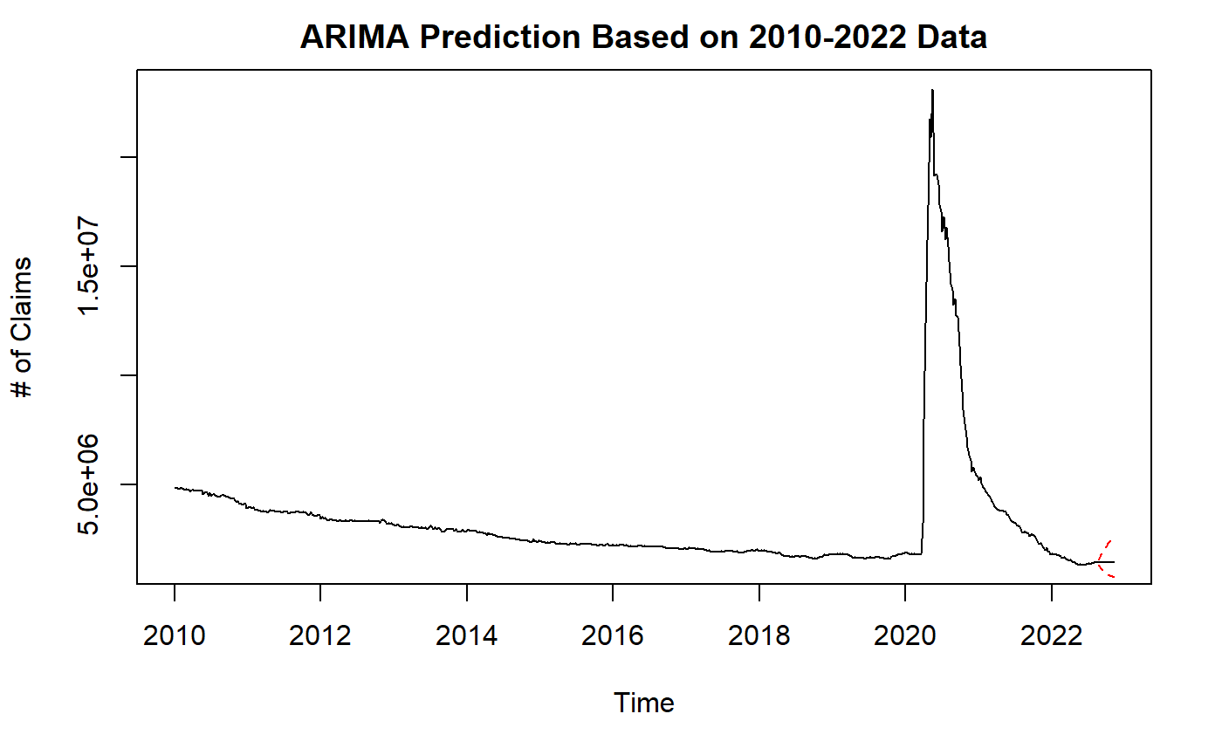
ARIMA Prediction for 2010-2022: ARIMA(3,1,2)

Slide 19
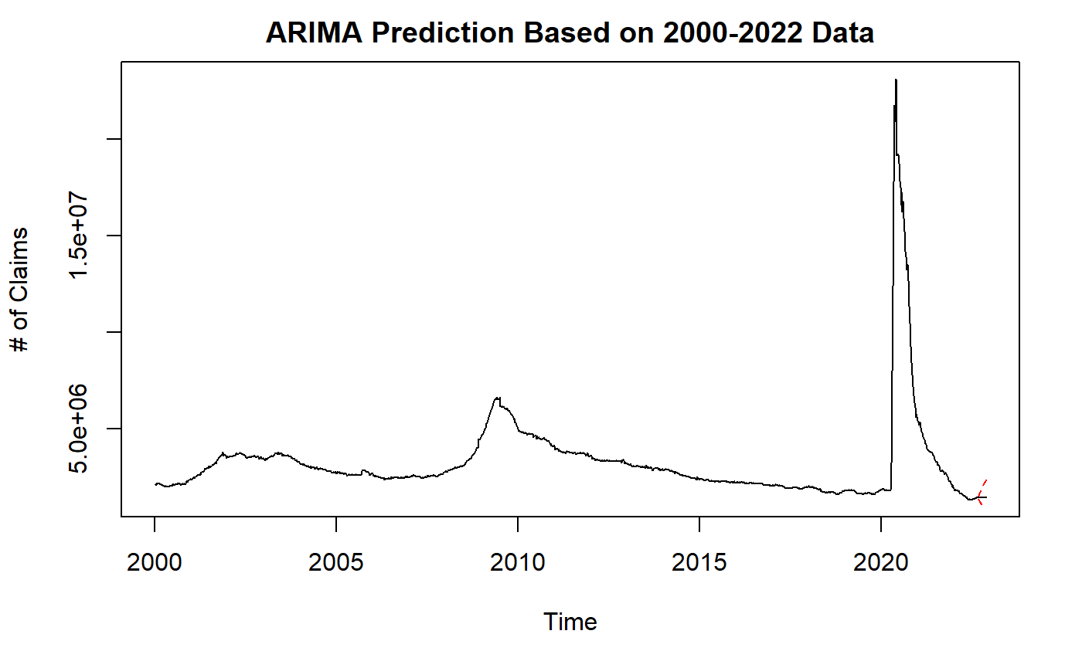
ARIMA Prediction for 2000-2022: ARIMA(2,1,3)

Slide 20
Comparing ARIMA Prediction Results
ARIMA(3,1,2) 10-22 | 1,412,609 | 1,413,950 | 1,408,385 | 1,405,152 | 1,406,330 | 1,402,840
 | 1,404,650 | 1,402,747 | 1,403,519 | 1,403,002 | 1,402,990 | 1,403,097
ARIMA(2,1,3) 00-22 | 1,418,312 | 1,424,283 | 1,417,554 | 1,421,322 | 1,417,399 | 1,419,751
 | 1,417,450 | 1,418,906 | 1,417,550 | 1,418,445 | 1,417,642 | 1,418,191

Slide 21
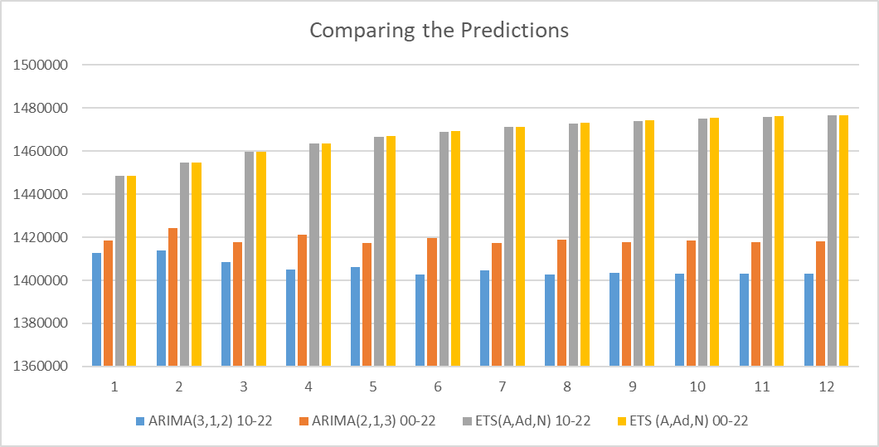
Four Predictions in a Glance

Slide 22
Compare Accuracy of Four Predictions
 | ME RMSE MAE MPE MAPE MASE ACF1 Theil's U | AIC | BIC
ETS 00-22 | Training set -118.2579 256812.8 66621.9 0.02613889 1.521314 0.0517206 -0.04634853 NA | 37688.23 | 37718.66
ETS 10-22 | Training set -1410.439 334910.9 83526.69 0.01028601 1.675801 0.04559996 -0.04696425 | 20990.62 | 21017.54
ARIMA 00-22 | Training set -195.7709 235461.5 70782.72 0.007095462 1.760376 0.9671071 -0.009392377 | 32499.26 | 32529.69
ARIMA 10-22 | Training set -1902.72 308808.8 90036.61 -0.03986636 2.02907 0.9168299 -0.0228652 | 18460.3 | 18487.22

Slide 23
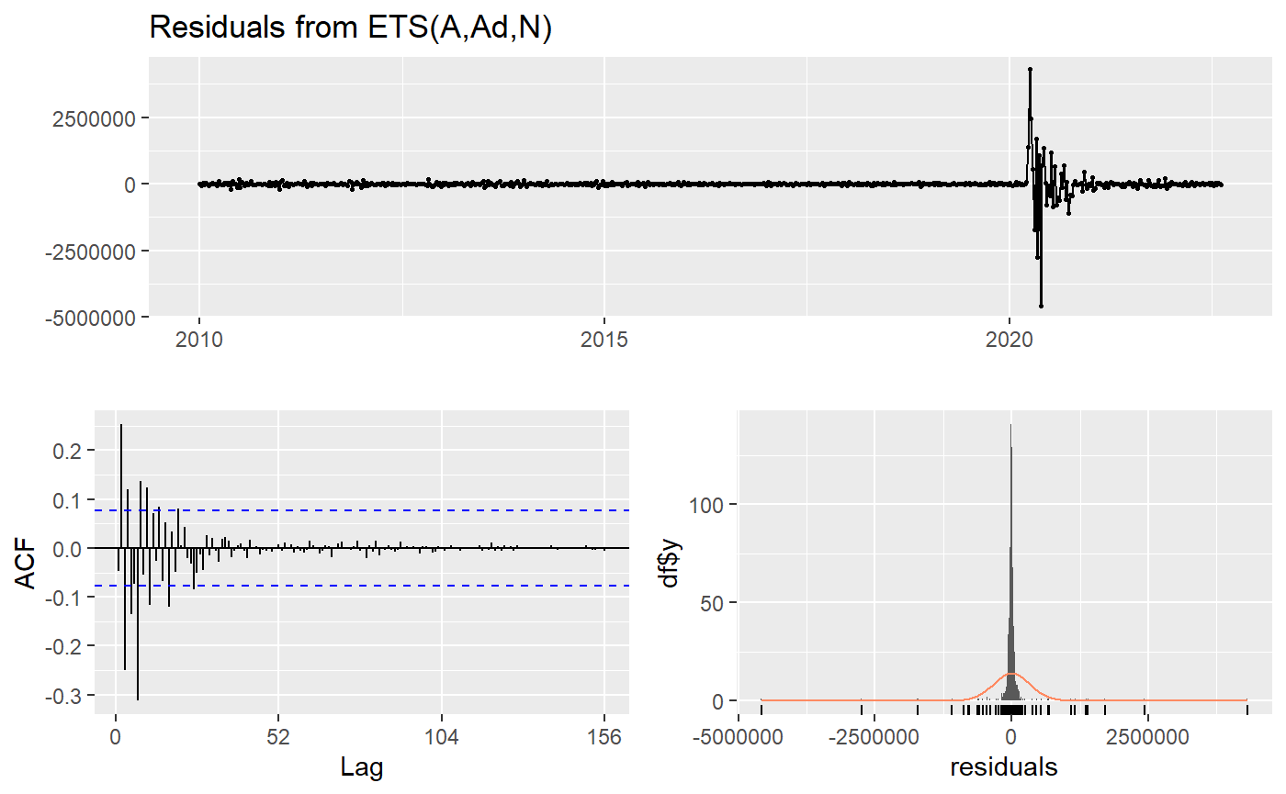
Ljung-Box test
data: Residuals from ETS(A,Ad,N)
Q* = 256.41, df = 99, p-value = 6.661e-16
Model df: 5. Total lags used: 104

Slide 24
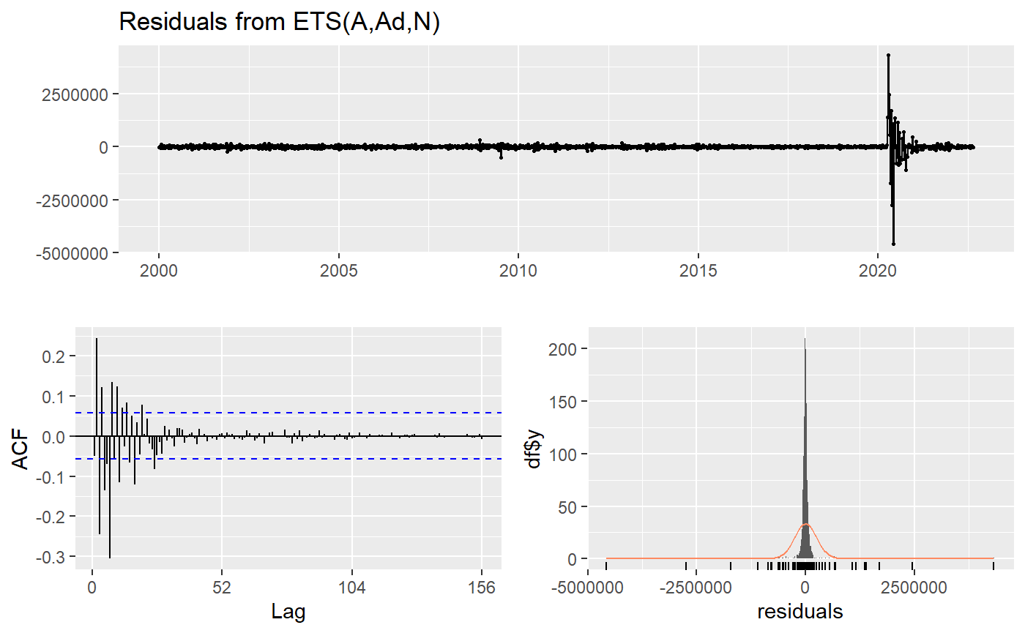
Ljung-Box test
data: Residuals from ETS(A,Ad,N)
Q* = 437.62, df = 99, p-value < 2.2e-16
Model df: 5. Total lags used: 104

Slide 25
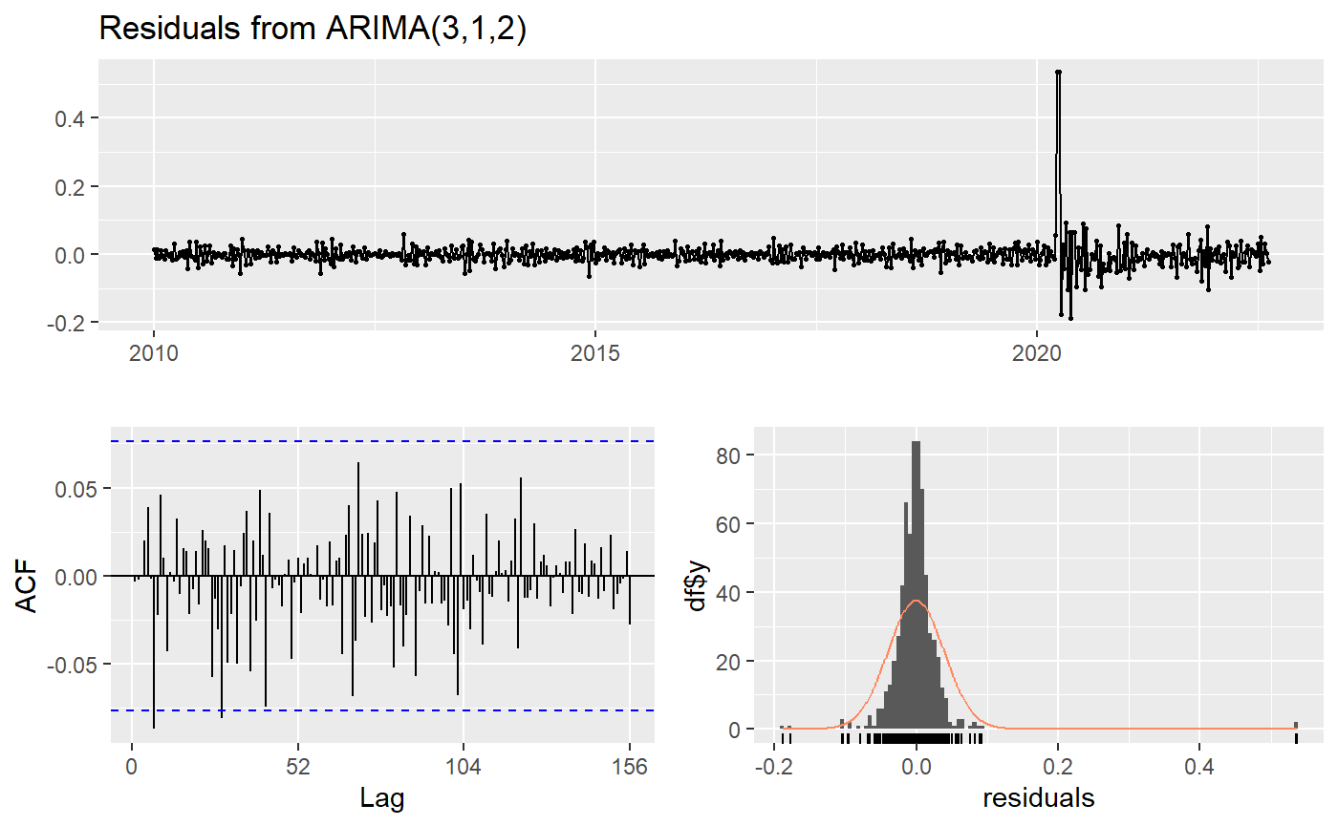
Ljung-Box test
data: Residuals from ARIMA(3,1,2)
Q* = 73.715, df = 99, p-value = 0.9731
Model df: 5. Total lags used: 104

Slide 26
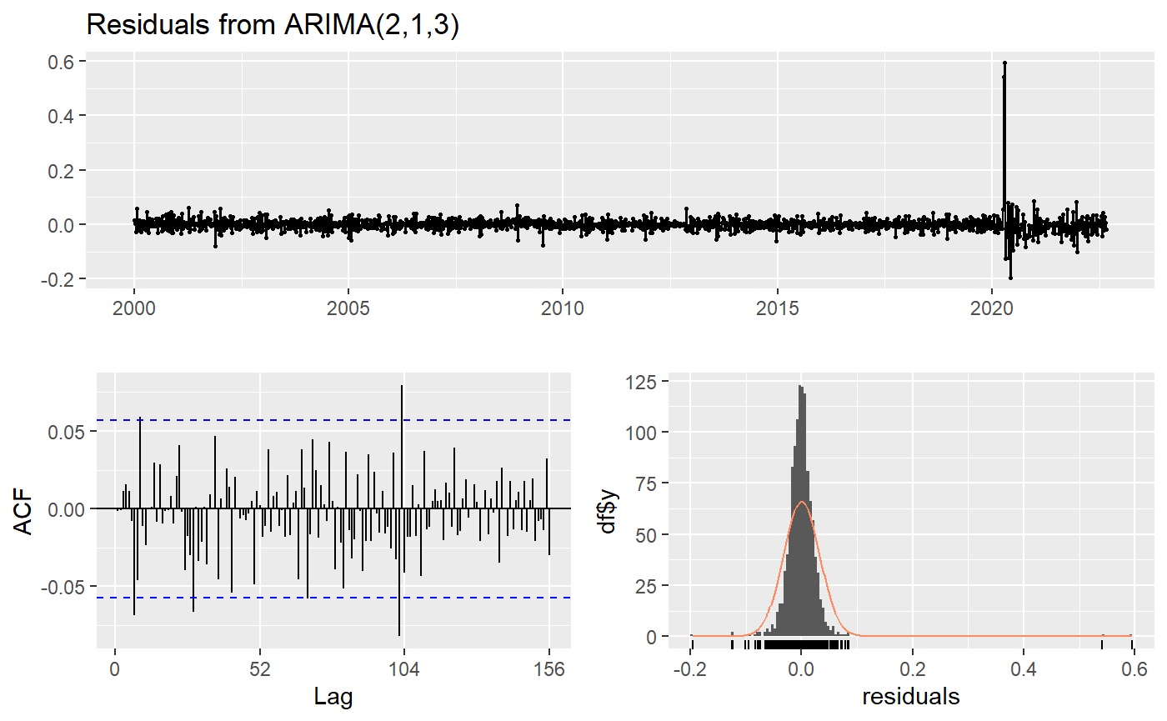
Ljung-Box test
data: Residuals from ARIMA(2,1,3)
Q* = 104.55, df = 99, p-value = 0.3321
Model df: 5. Total lags used: 104

Slide 27
Results
10-22 models have better fits than 00-22 models (based on AIC)
ARIMA models fit better than ETS models
Residuals from ETS models still have correlations
Predictions suggest unemployment will be managed

Slide 28
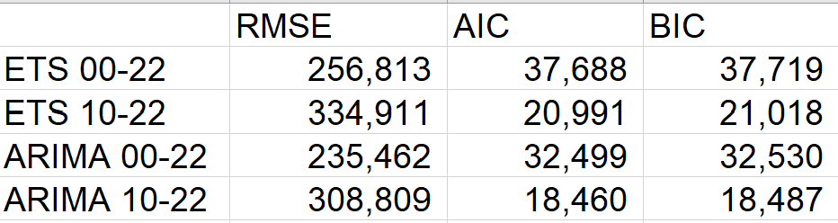
Limitations
AIC & RMSE indicate different accuracy comparison
ARIMA used whole set as training set
Notes:
These are the results and limitations based on our projections. Next, Bruce will discuss how the findings are beneficial to real world issues.

Slide 29
Discussion
Bruce Zhao

Slide 30
Discussion
Effectiveness of Unemployment Benefits
Time Selection of Analyzing Unemployment Problems
Global Applications

Slide 31


Effectiveness of Unemployment Benefits
OR

Slide 32
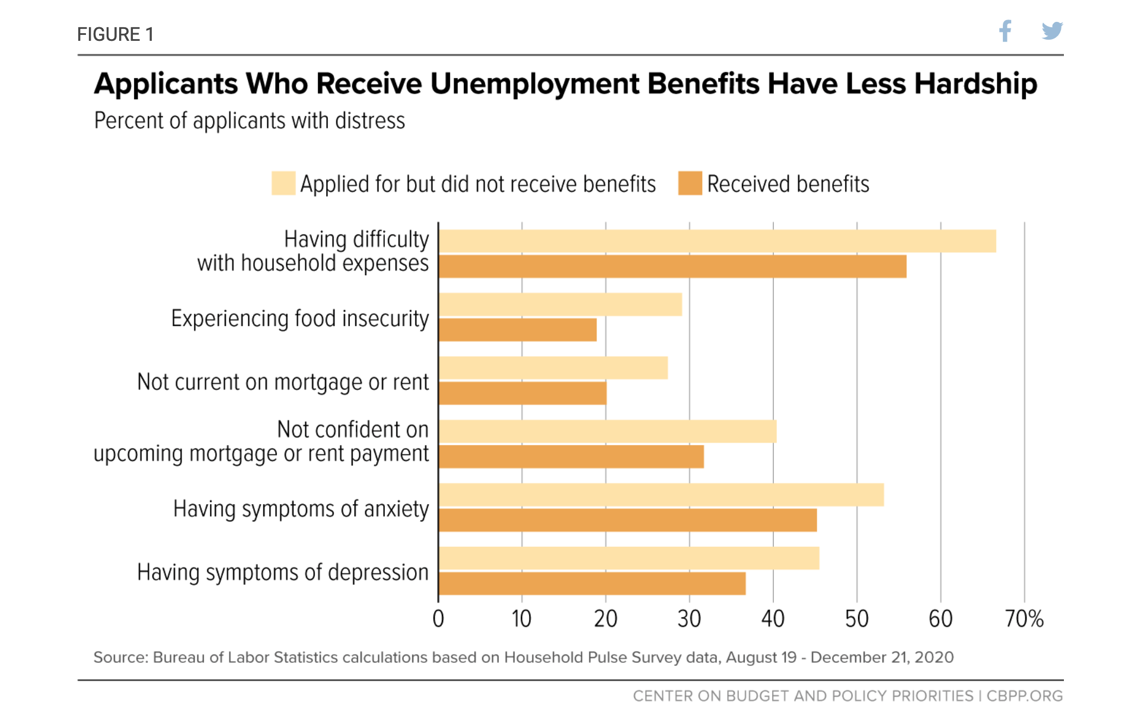
Effectiveness of Unemployment Benefits

Slide 33


Time Selection of Analyzing Unemployment Problems
OR

Slide 34


Time Selection of Analyzing Unemployment Problems
Dot-com bubble (2000)
Global Financial Crisis (2008)

Slide 35
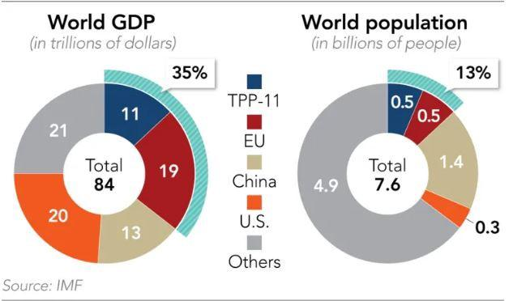
Global Applications
Year 2019

Slide 36
Q & A
Introduction
Method
Result
Discussion

Slide 37
Reference
U.S. Employment and Training Administration, Continued Claims (Insured Unemployment) [CCSA], retrieved from FRED, Federal Reserve Bank of St. Louis; https://fred.stlouisfed.org/series/CCSA, August 25, 2022.
Şahin, A., Tasci, M., & Yan, J. (2020). The unemployment cost of COVID-19: How high and how long?. Economic commentary, (2020-09).
Petrosky-Nadeau, N., & Valletta, R. G. (2020). An unemployment crisis after the onset of COVID-19. FRBSF Economic Letter, 12, 1-5.

